Slide 1

Introduction to Blogs
Integrated Professional Skills in the Digital Age
Lesson 1

Slide 2
Learning outcomes
History of Blog
What is a Blog?
Types of Blogs
Blog search engines
Why do people blog
Blogging Statistics

Slide 3
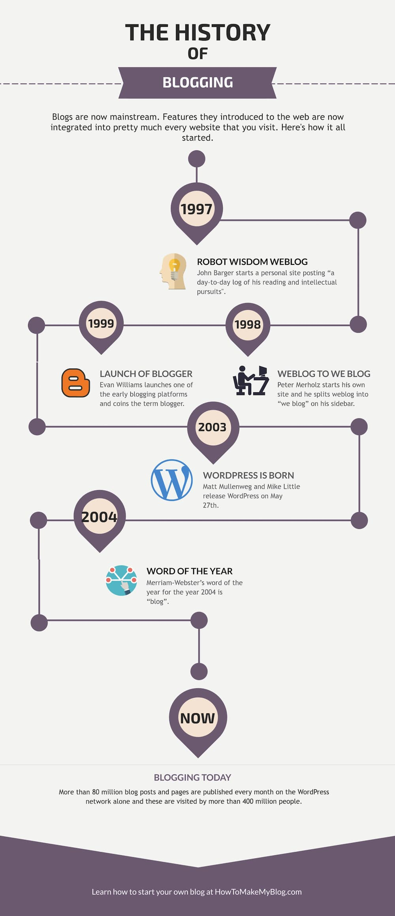
History of blog
The emergence and growth of blogs in the late 1990s coincided with the advent of web publishing tools that facilitated the posting of content by non-technical users.

Slide 4

What is a blog?
A website where entries or posts are written in chronological order and commonly displayed in reverse chronological order
Accessible by anyone on internet
It is a web application that contains a periodic time-stamped posts on a webpage
A blog is often published using a CMS or Content Management System, which is a software application or set of related programs that are used to create and maintain digital content
Most blogs are primarily textual, although some focus on art (art blogs), photographs (photoblogs), videos (video blogs or "vlogs"), music (MP3 blogs), and audio (podcasts).

Slide 5
"Your blog is a honeypot, not a megaphone. Make a point to position your content around what your audience wants to discover, not what you want to tell them."
Amanda Sellers, HubSpot's Historical Optimization Write

Slide 6

How is Blog different from a website?
A website has a blog
This website has a blog in addition to other services, products etc. to post regular content related to their product or service
Examples:
Adventure Associates
https://www.adventureassoc.com/
River Pools & Spas is a website with a blog
https://www.riverpoolsandspas.com/
Problogger.com

Slide 7
Blogging statistics
There are currently more than 600 million blogs on the internet out of the 1.7 billion websites.
The number of active bloggers in the United States is estimated to hit 31.7 million in 2020.
86 percent of content marketers use blog posts as part of their marketing strategy.
The average blog post today has 1236 words. That’s 53 percent more than the average blog post six years ago.
It takes bloggers an average of 3 hours and 57 minutes to produce a blog post.
Bloggers say the most important factor for success is the quality of content.
97 percent of bloggers use social media to promote their blog posts.
Businesses that publish 16 or more posts per month receive 3.5 times more traffic than those who publish fewer than four posts.
60 percent of consumers say blog posts are valuable in the early stages of the buying process.
More than half of content marketers say blog content is their top inbound marketing priority.
(Oberlo, 2020)

Slide 8
Examples of blogs
These are only a few examples, there are many!
Greatist
Nerd Wallet
Nomadic Matt
Nerd Fitness
Art Of Manliness
CSS Tricks
The Penny Hoarder
CoinDesk
ArsTechnica
Bustle
Wellness Mama
Thought Catalog
Fatherly
(Alphainvestors, 2020)

Slide 9
Types of blogs
Types of blogs
Corporate
Community
Professional
Microblogs
Personal

Slide 10
Why do people blog?
There are many reasons, but a few important ones are:
It helps to process your thoughts.
Often thoughts which are not written down are forgotten
It improves your command on that language
Increases vocabulary of words
Helps in creative thinking
Improves memory
Helps in group discussion - And if you write then you will read and do lot of things like make friends, start your own band, win competitions, express yourself, network, voice your opinion, etc.

Slide 11

Personal blogging
Personal blogging is usually writing about personal chronicles, may be daily activities, visits to new places, poems, thoughts on life, etc.
Bloggers write personal blogs as it
Gives avenues of self-expression
Shot of fame
Gives a thriving social community
Library of readers
A chance to be spotted by some publisher
And sometimes chance to earn money

Slide 12

Corporate blogging
A Corporate blog is a professional blog, mostly linked to the company website and usually updated by the corporate communication dept.
Corporate blogs are written for following purposes:
Update on new initiatives like employee development, new products, services, awards, etc.
Thoughts of the MD, Chairman or Senior management about the company’s future plans.
Updates on the company’s exposure in media.

Slide 13

Professional blogging
Professional blogging is for monetary benefits, these bloggers are fulltime bloggers and write on various topics. These blogs are often visited and have large number of followers.
Professional blogs are written for the following purposes:
News blogging.
Technology updates blog, or how to use different software’s
Political analysts
Authors often write blog, to connect with readers
Food reviews and recipes blogging
Professional travellers often posting their experiences

Slide 14
microblogs
Microblogs are short blogs or status updates. We have heard about Twitter, WhatsApp or Facebook updates.
These are hugely popular among web users, as it takes just a minute to update it and also easy to track updates of the people you follow.
People just get hooked to it as these are instant and after reading easy to comment.

Slide 15
Community blogging
Community blogging is a group blog often focusing on selected subjects. It is easier for search engines to track these blogs and this is the main reason behind its popularity.
Bloggers often blog at these places as
Simple to set-up.
Topics are generic like, budget issues, food reviews, etc.
Improve thought process and creative thinking
Gets immediate recognition

Slide 16
Blog search engines
BlogSearchEngine.com
Blogorama.com
Bloggernity.com
Blogcatalog.com
Searchblogspot.com
Alltop.com
Blogs.botw.org
(Lifewire. 2020)

Slide 17
Dangers of Personal blogging
Cyberstalking, which is a new phenomenon that allows online stalkers to prowl for victims.
Especially females, should be cautious when creating their own personal blogs.
The following measures could be taken to avoid Cyber stalking:
Do not have an online profile
Post anonymously
Avoid personal or identifying details
No photos
Avoid inappropriate dialog
Lurkers
Timeless
Learn more about internet safety at iSafeVentures.com
(Housley, n.d.)

Slide 18
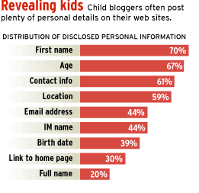
Dangers of Personal blogging
Too Much Information
Each piece of information seems harmless.
It’s when the predators put multiple pieces together that you have put yourself in danger.

Slide 19
1. Choose blogging platform
This is one of the tools of the trade that is needed to provide blogging.
There are many free tools available, such as WordPress, Blogger, Tumblr, TypePad and many more
WordPress has got biggest market share of approximately of 60%(w3techs.com, 2019)

Slide 20
2. Choosing a webhost
A webhost is a company that puts your website on the Internet.
This can be free or paid (self hosting) monthly
Free providers are helpful for beginners, but they have limitations.
Paid (self hosting) ones are good for professional bloggers.
For example, JustHost.com

Slide 21
3. Setting up the blog
You must decide about the domain for your blog. A domain is simply your website address like facebook.com, google.co.uk etc
Free host or selfhosting?
Once hosting is completed, a tool like, WordPress must be installed. It would be much easier; you don’t have to be a techie.

Slide 22
4. Designing your blog
This starts with selecting a theme or a template usually provided by the tool provider like WordPress.
Your blog should reflect you and and your personality
It must be clutter free and user friendly
You may need a professional training if you are a professional blogger with the intension of making money

Slide 23
5. Useful resources for Beginner blogs
Look at some professional blogs to get an idea
You might make mistakes initially and you must learn from it.
However, there is always a room for more learning and improvement.

Slide 24



The tools of the trade
Name | Advantages | Disadvantages | Target users
 | Free & Open source Massive user & developer base Plug-ins and themes Hosted centrally or self-install | Complexity Most flexibility requires self-install | Professional bloggers
 | Free One of the earliest blogging platforms Ease of start-up Excellent Google integration (AdSense) | No back-end code access Limited customizations (themes and plugins) Difficult to set up own domain | Casual bloggers
 | Free Ease of use (post online, SMS, audio) Multiple blog support Mobile-friendly | Visual-centric, doesn’t encourage text-heavy blogging Emphasis on sharing devalues original | Casual bloggers who want something between Twitter and WP Photobloggers

Slide 25


The tools of the trade
Name | Advantages | Disadvantages | Target users
 | Oldest premium blogging platform Very good analytics & publishing tools Promotes blogs within internal blogosphere | Expensive, especially with free, powerful alternatives Lack of features and flexibility Dated | Casual bloggers who want something easier and more robust than WP/Blogger
 | Highly customizable (drag-n-drop) Dedicated mobile apps Easy to import blogs created on other platforms Built-in ecommerce solution | Expensive No back-end code access Limited customizations (themes and plugins) | Creative professionals and businesses that want a cloud-based, no-nonsense blogging solution with extensive customization options
There are also tons of others, but either in limited market share or limited availability (beta).

Slide 26
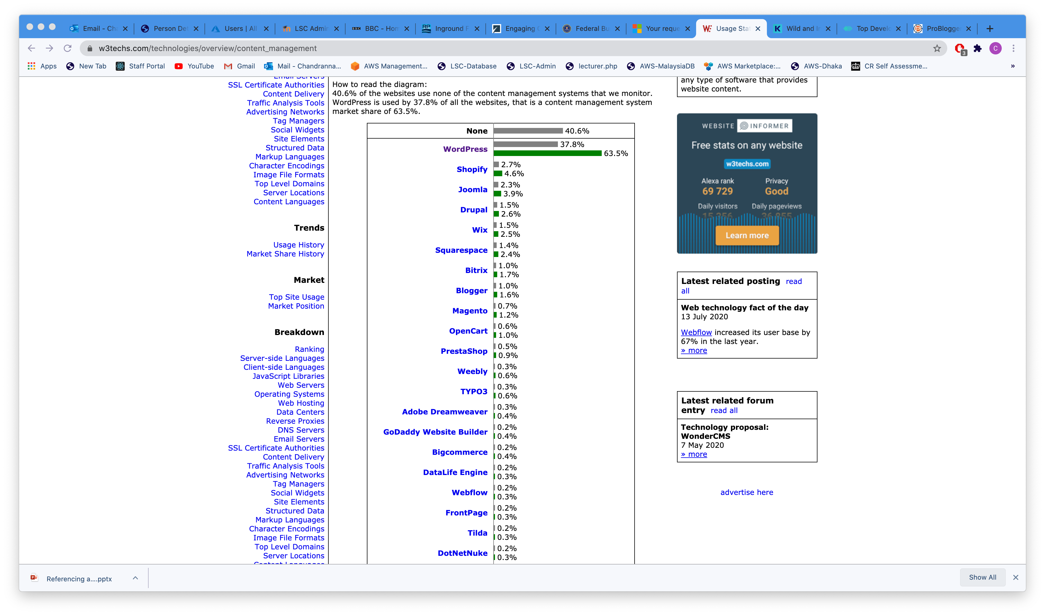
Tools statistics
How to read the diagram:
40.6% of the websites use none of the content management systems that are monitored. WordPress is used by 37.8% of all the websites, that is a content management system market share of 63.5%.
(W3tech.com, 2020)

Slide 27
10 minutes break

Slide 28


Seven Steps to Create impactful blogs
Focus on your target audience
Write Compelling Headlines
Add Subheadings and Shorter Paragraphs
Include Visual content
Design for SEO
Have ‘Call-to-Action’ and ‘Exit-Intent’
Setup activity notification

Slide 29
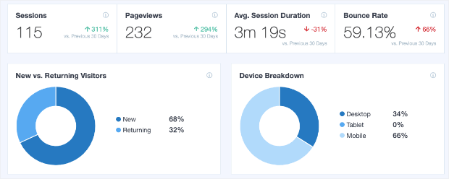
Creating impactful blog Focus on your target audience
1
Review blog readers, where they are coming from, Calculate average scroll depth to know how far visitors read your post before they lose interest using insight tools

Slide 30
Creating impactful blog Write Compelling Headlines
Top 5 headlines types
The 'Make My Life Easier' Headlines
The 'It's a Race' Headlines
The 'If I Were You' Headlines
The 'What We Do When...' Headlines
The 'Backed By Science' Headlines
The 'Why X People Do X' Headlines
2
Using appropriate and catchy headlines must to appeal to their target personas
Make it the clickable and SEO-friendly headlines that bring in more traffic.

Slide 31

Creating impactful blog Add Subheadings and Shorter Paragraphs
3
Formatting is super important for blog posts. There is nothing worse than reading a blog post that is just one giant paragraph.
Most of the time people skim through the content before they actually decide to read it. breaking up your article with subheadings make it easier to skim read.

Slide 32
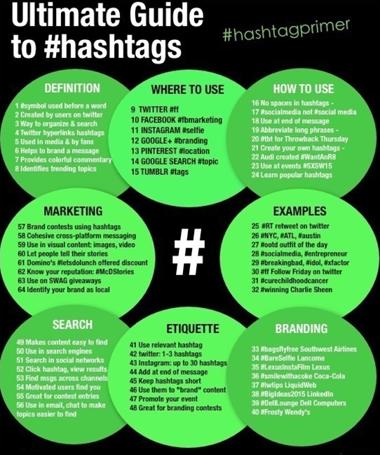
Creating impactful blog Include Visual content
4
Use of bullet points, images and illustrations makes reading easy
Do not over use visuals and use relevant and interesting images to break the lengthy texts

Slide 33

Creating impactful blog Design for SEO
5
Organic searches on Google drives a huge chunk of the traffic for most websites
Balance SEO requirement with content

Slide 34

Creating impactful blog Have ‘Call-to-Action’ and ‘Exit-Intent’
6
Ask your readers to leave a comment, share your blog post, follow you on social media, or purchase your products
Have an exit-intent or purpose for blogs to convert readers to subscribers or customers

Slide 35

Creating impactful blog Setup activity notification
7
Social proof works in two ways. First, uses fear of missing out (FOMO) - wanting what others have or Secondly, we are more likely to take an action or buy something if we see others are doing the same.
For example, having welcome notifications and all recent activity can be used to build connection. On high converting pages, you can display recent sales to maximise conversions.

Slide 36
references
Alphainvestors, 2020. 31 Examples Of Successful Blogs: The Most Popular Blogs In Every Industry. [Online] Available at: https://alphainvestors.com/blogging/examples-successful-blogs/ [Accessed 10 08 2020].
Lifewire. 2020. Find Blogs You Want To Read. [online] Available at: <https://www.lifewire.com/how-to-find-blogs-3476351> [Accessed 10 August 2020].
Oberlo, 2020. 10 Blogging Statistics You Need to Know in 2020. [Online] Available at: https://www.oberlo.co.uk/blog/blogging-statistics [Accessed 10 08 2020].

